Slide 1

Deep Learning for medical image recognition
Chen DANG & Hippolyte DEBERNARDI
Supervised by Ronan SICRE

Slide 2
Introduction
Description of a convolutional neural network
Presentation of the CNN chosen
Data sets we used
Overview of Transfer Learning
Fixed Feature Extraction
Pre-trained models
Fine-tuning
Histogram equalization & Data augmentation
Final results
Conclusion

Slide 3
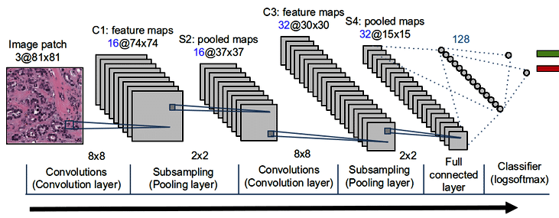
Convolutional Neural Network

Slide 4
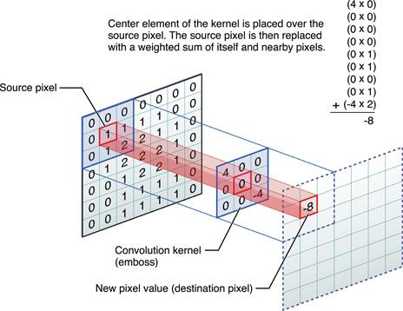
3 major parts that compose a CNN
Convolution

Slide 5
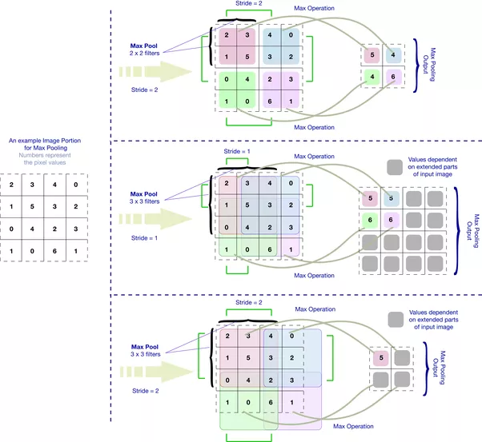
3 major parts that compose a CNN
Pooling

Slide 6
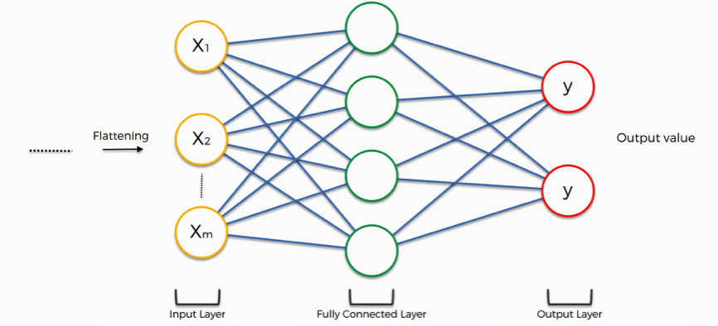
3 major parts that compose a CNN
Fully connected layer

Slide 7
Data sets used
 | # of classes | # of images for train, test, val | size & resemblance to imagenet | image size
Chest X-ray (Pneumonia) | 2 | 5221, 624, 16 | decent, very far | variable (smallest value is 640)
Cancer cells | 2 | 72, 26, 26 | very little, far | 4000, 3000
Kvasir v2 | 8 | 4800, 1600, 1600 | decent, far | 720, 576
Mini MIT Etus | 3 | 120, 120, 0 | very little, very close | variable (some are close to 128)

Slide 8
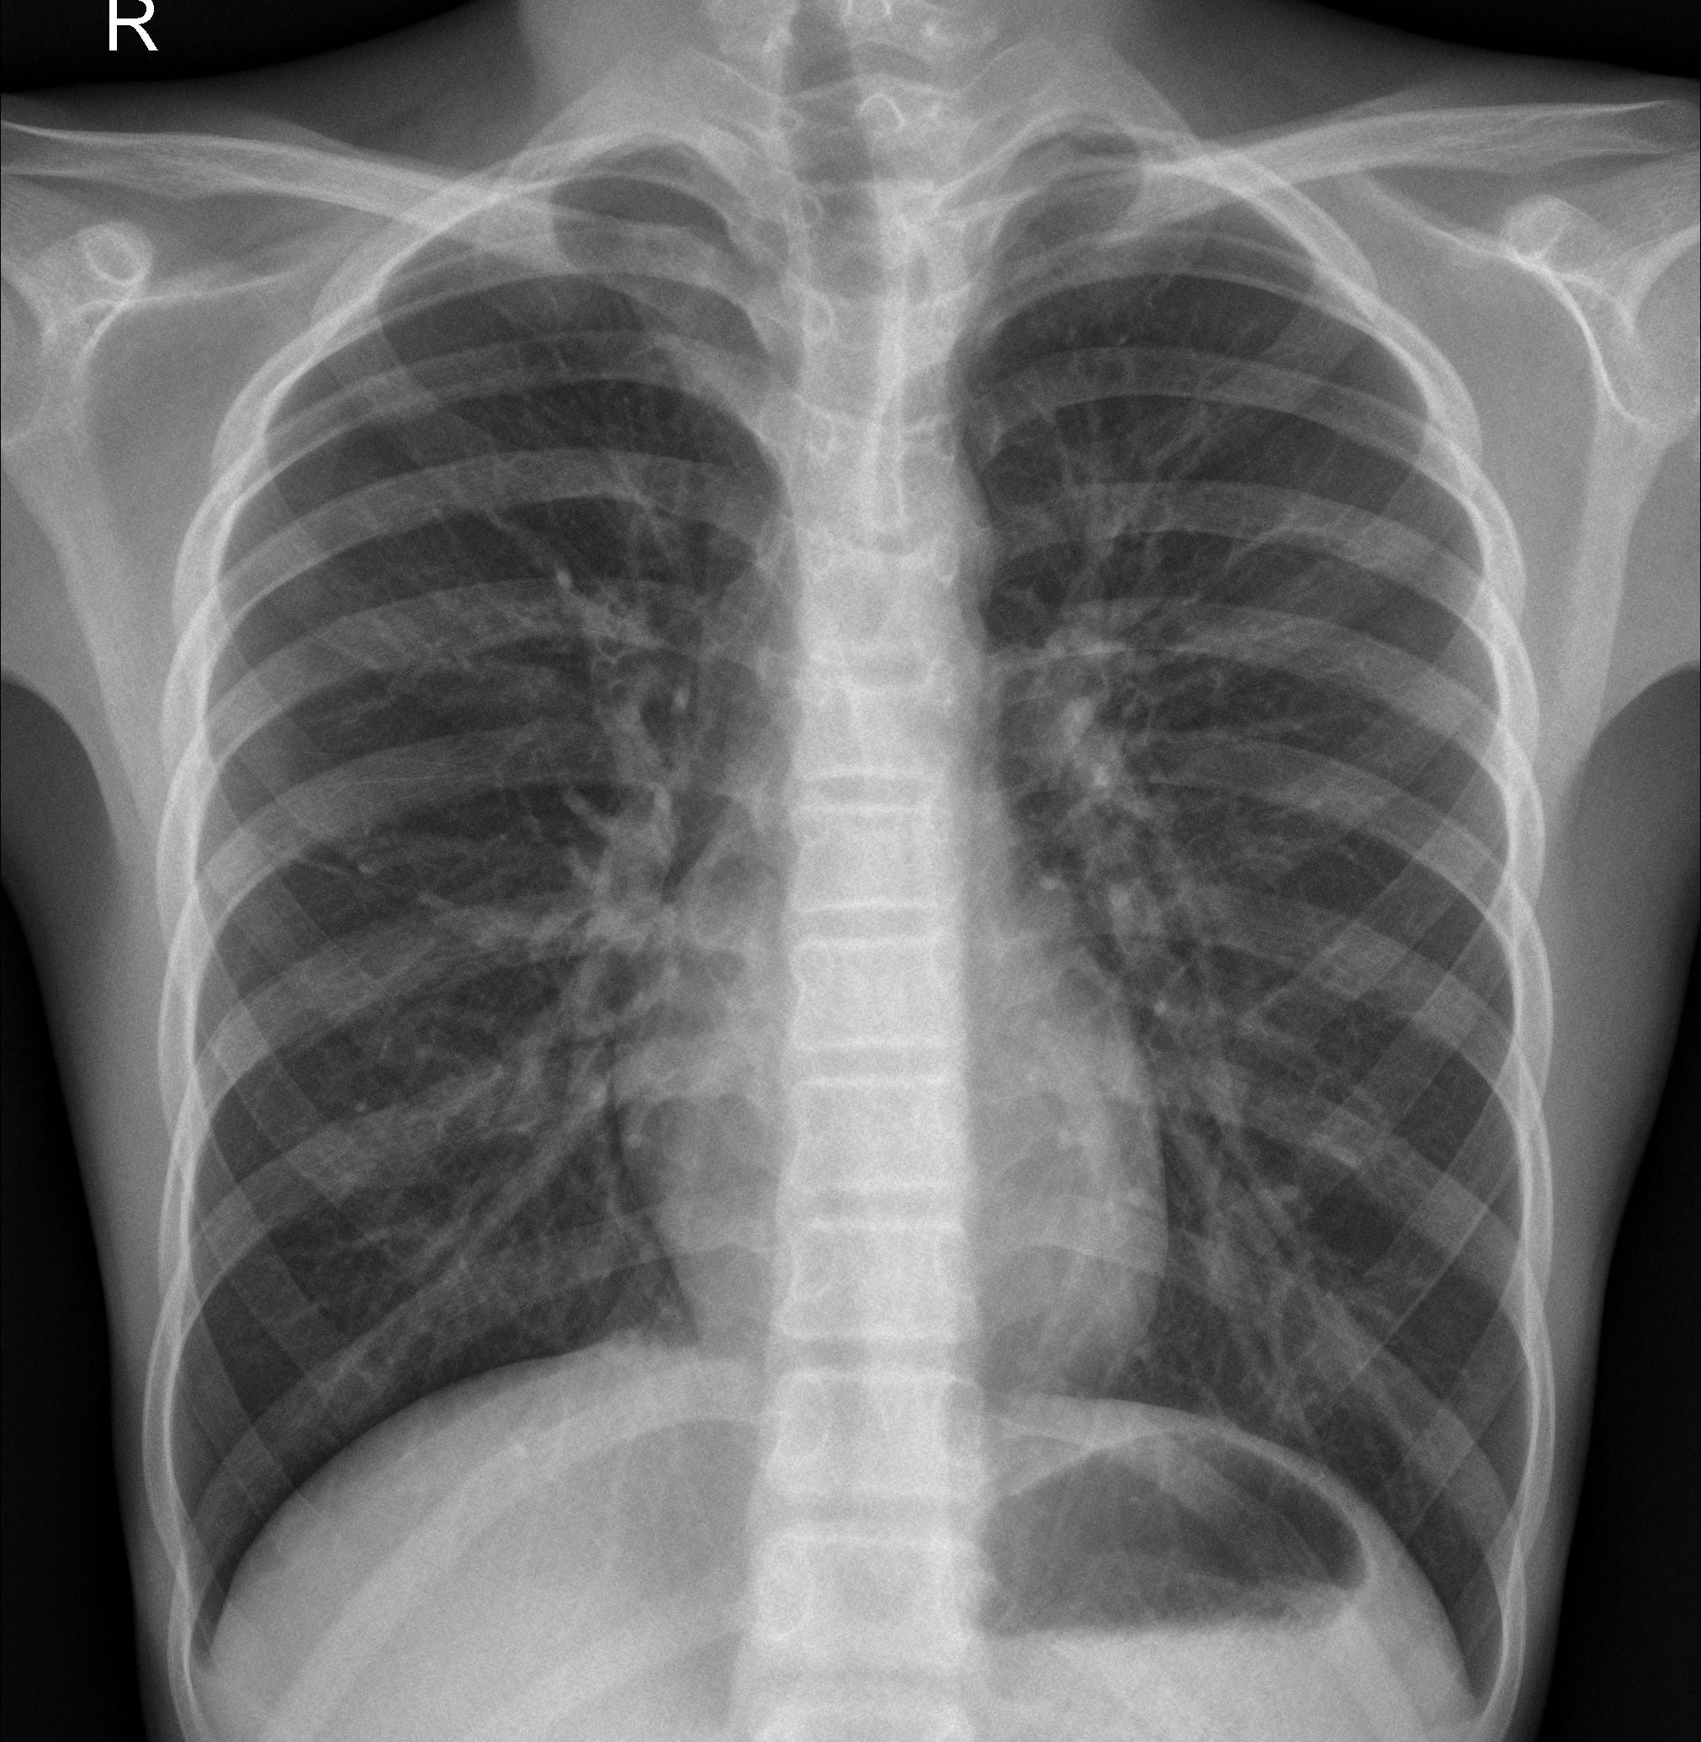
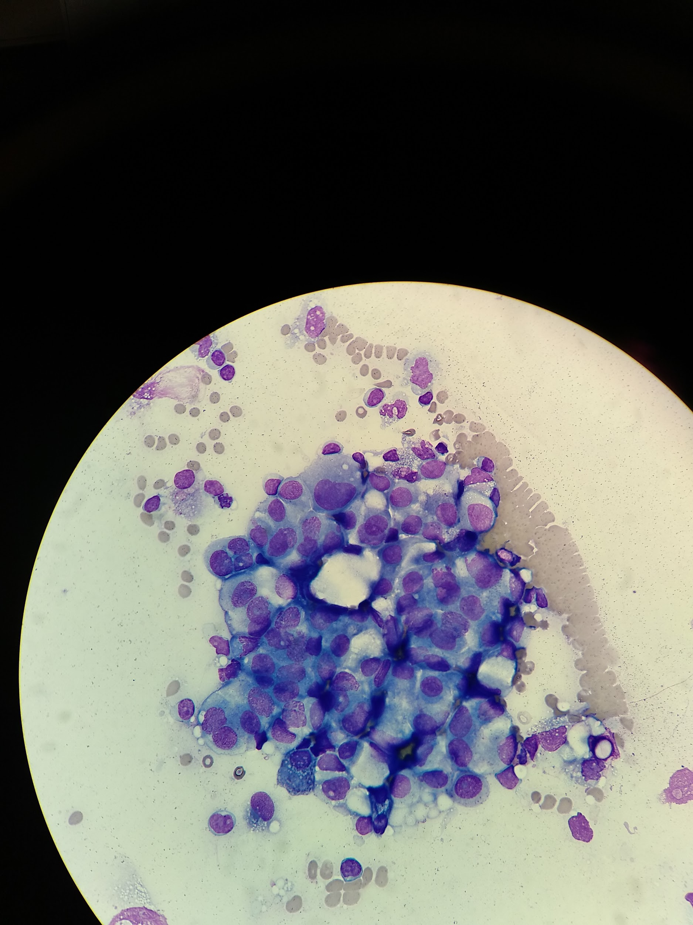
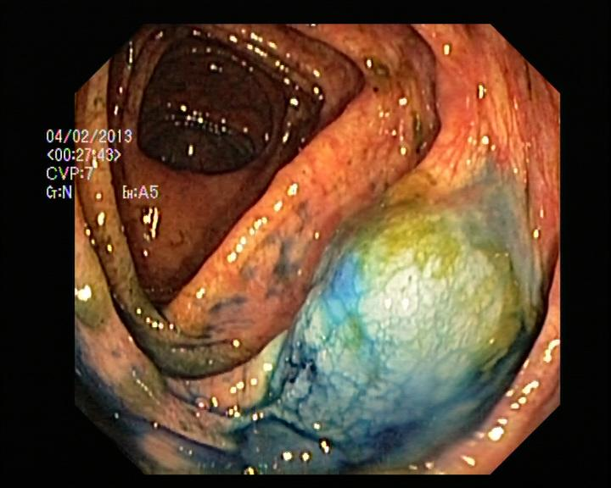


Slide 9
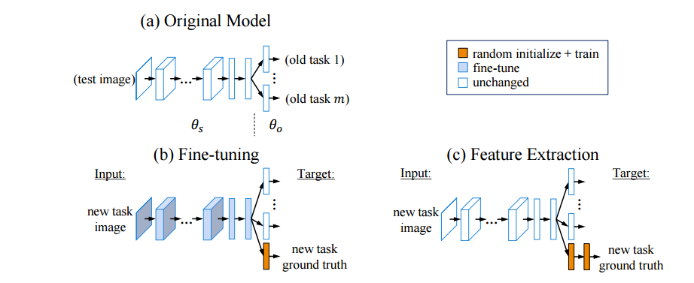
Transfert Learning

Slide 10
Fixed Feature Extraction
CNN codes
Fully connected layer to fully convolutional layer
VGG-19 + SVM
VGG-19 + VLAD + SVM

Slide 11
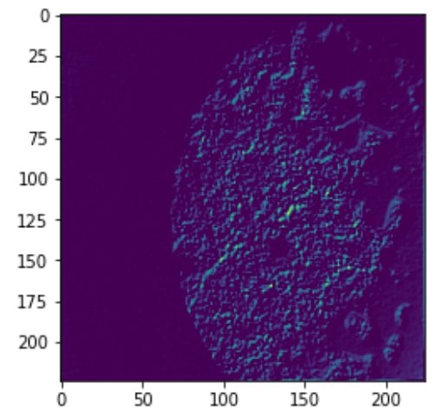
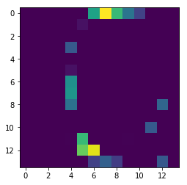
CNN codes
Assumption : more convolutional layers lead the network to be able to represent more complicated/specified features
block1_conv1 block5_conv1

Slide 12
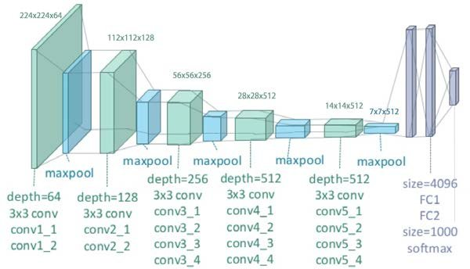
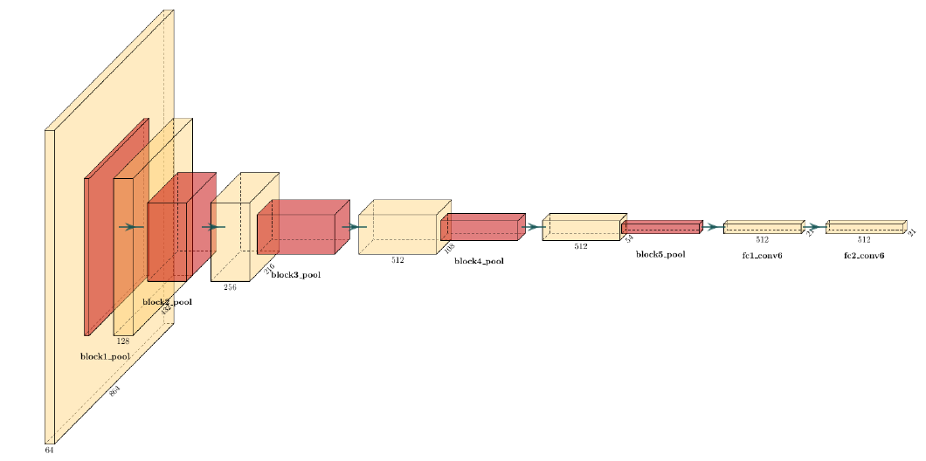
Fully connected layer to fully convolutional layer
VGG-19 image size : (224, 224)
Wanted image size : (224 + 320n, 224 + 320n), where n = 0, 1, 2
Initial VGG-19 Transformed VGG-19

Slide 13
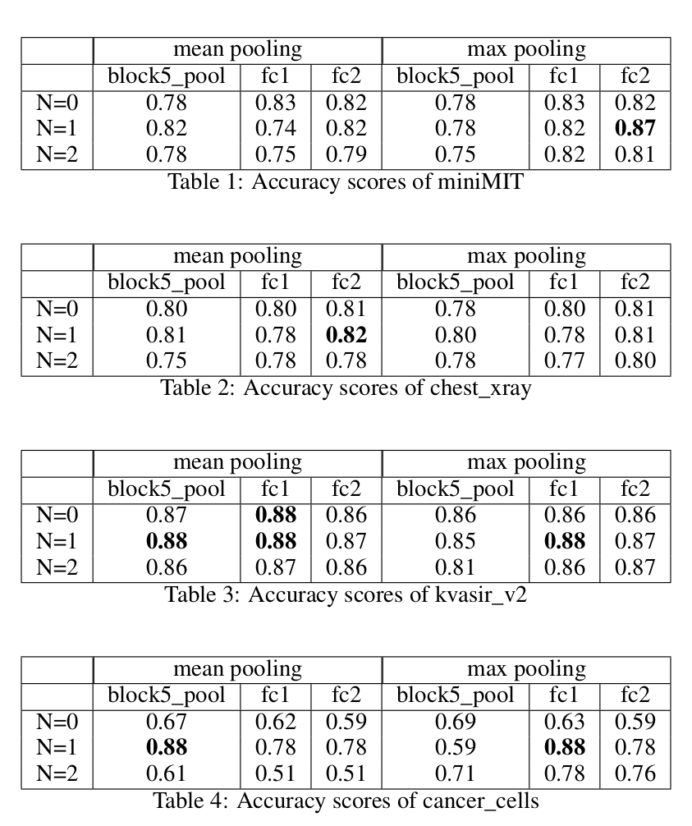
VGG-19 + SVM
Increasing size of input image given to the network matters !
n = 1 (224 + 320) seems to be the best parameter nearly always

Slide 14
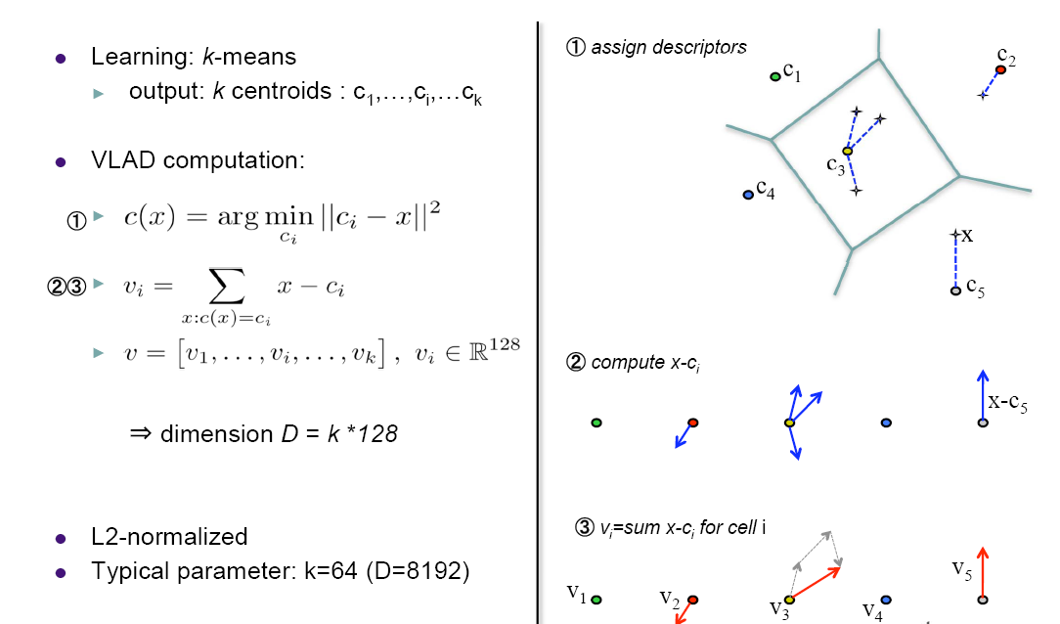
VLAD (Vector of Locally Aggregated Descriptors)

Slide 15
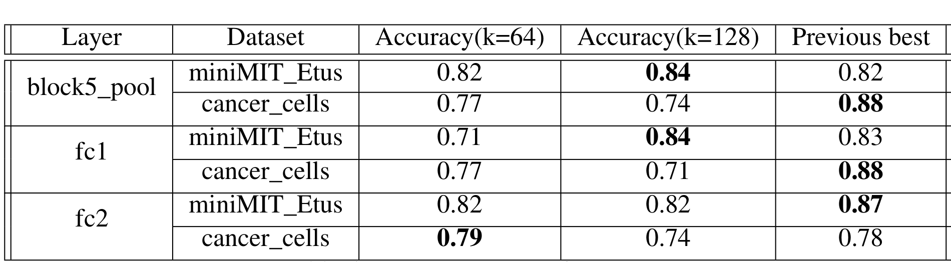
VGG19 + VLAD + SVM
VLAD doesn’t really increase the performance or slightly

Slide 16
Fine-tuning VGG-19 network
Take a pre-trained model and try to find the best layers to train again

Slide 17
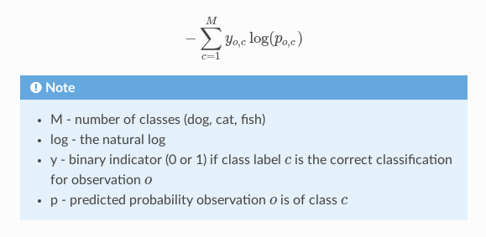
Training parameters
300 epochs with an early stopping callback fixed at 20
Optimize Adam with initial learning rate 1e-6

Slide 18
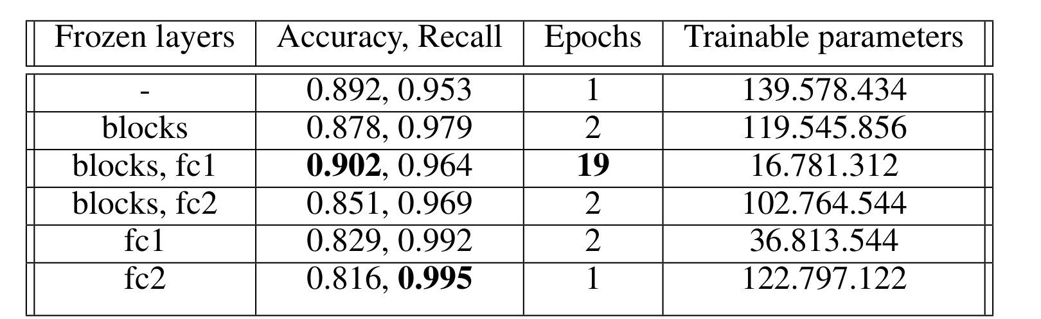
Baseline on Chest X-ray
Train the last two layers makes sense !

Slide 19
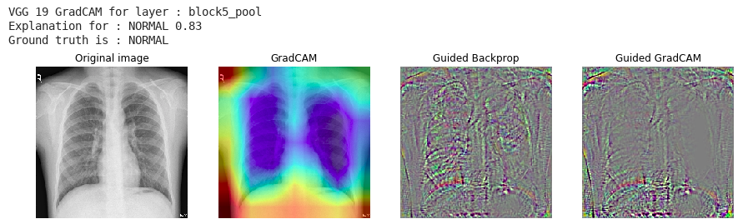
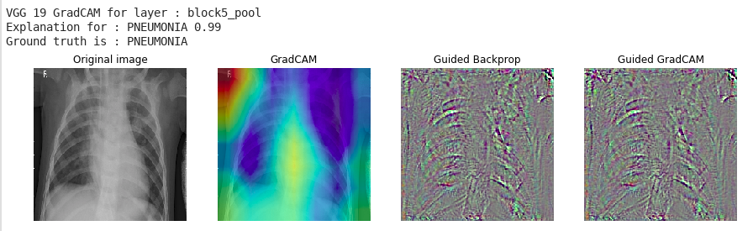
Let’s try to visualize what we predict

Slide 20
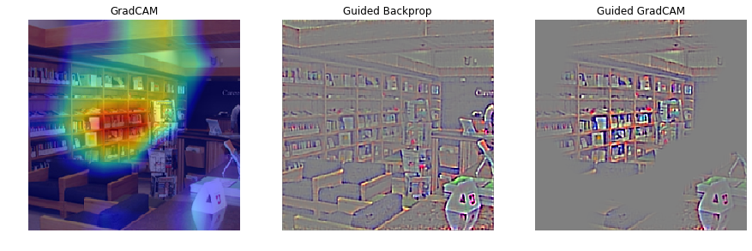
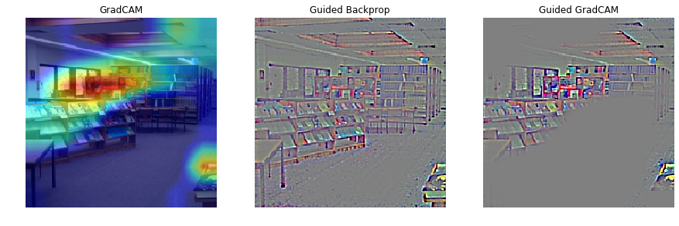
GradCAM comparison : MIT data set (block5_pool)

Slide 21
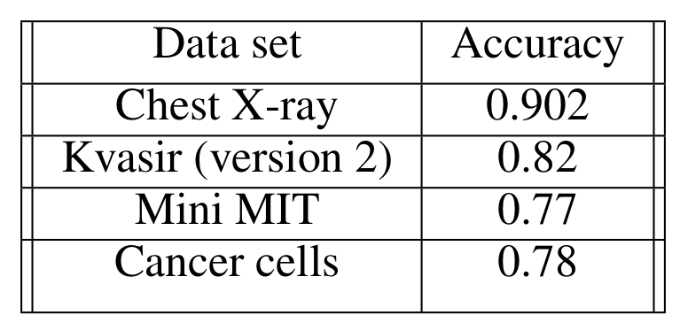
What we can conclude at this point
Pre-trained models perform better on larger data sets
Pre-trained models, even on larger data sets, are overfitted
A network is strong or weak if it can motivate its output
Thus, we decide to explore a way to improve our network in terms of interpretation along to get better metrics results.

Slide 22
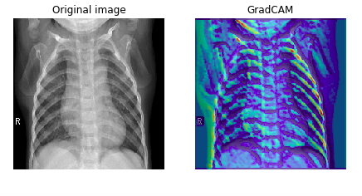
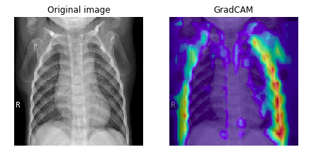
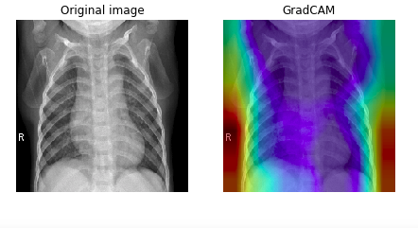
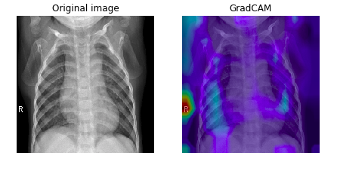
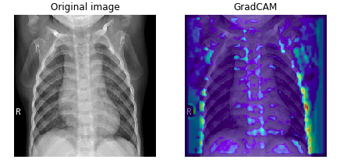
Prediction visualisation for each pool layer

Slide 23
Xception network and depthwise convolutions
Xception network by François Chollet (creator of Keras)
Depthwise convolution decrease the computing time with nearly the same result as a normal convolution
Main difference is that we transform an image once then elongate it to the number of channels desired
Based on VGG-19 first 3 blocks, we construct 2 blocks of Depthwise convolution followed by a normalization to prevent overfitting

Slide 24
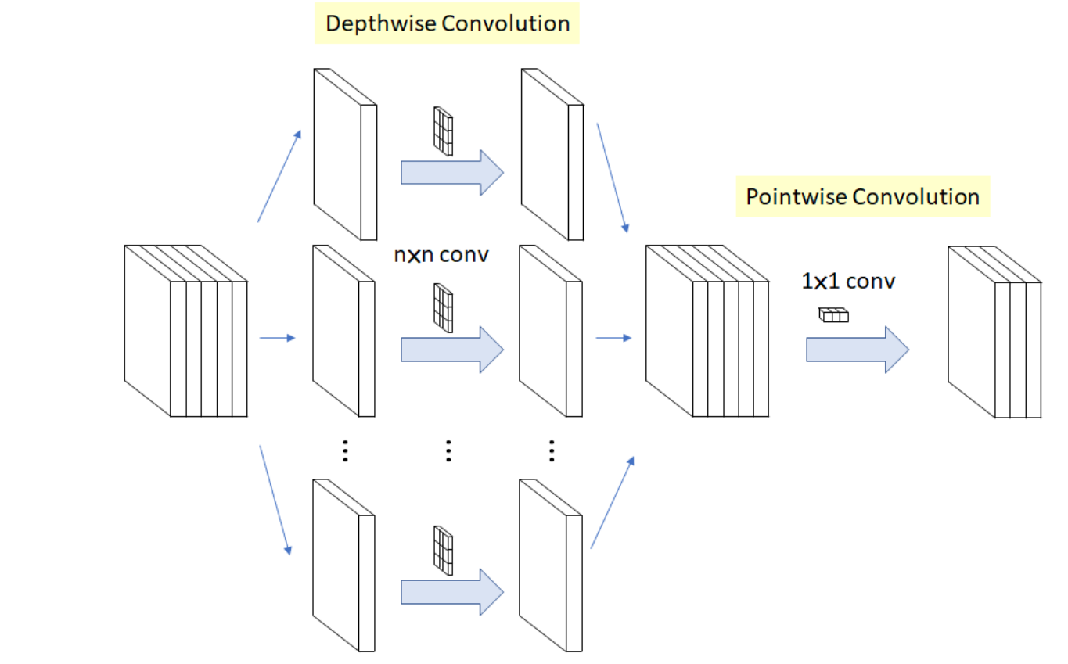
Depthwise convolution

Slide 25
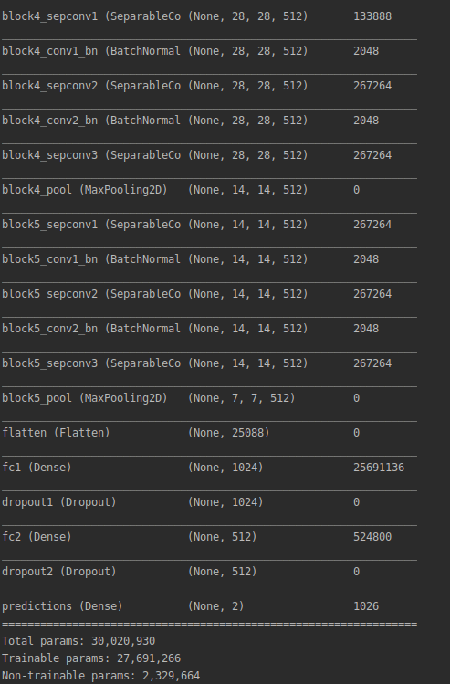
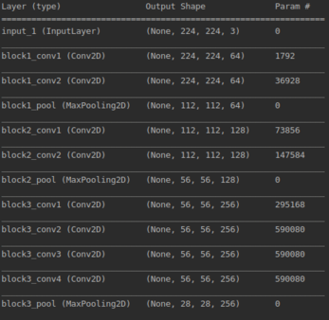
CNN architecture

Slide 26
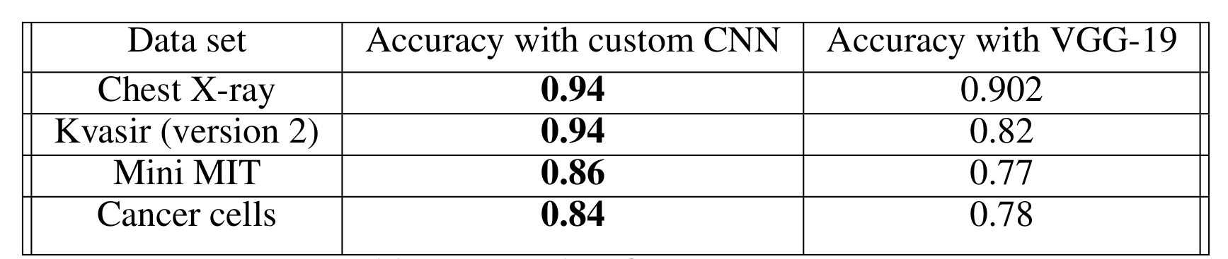
Results obtained with that CNN

Slide 27
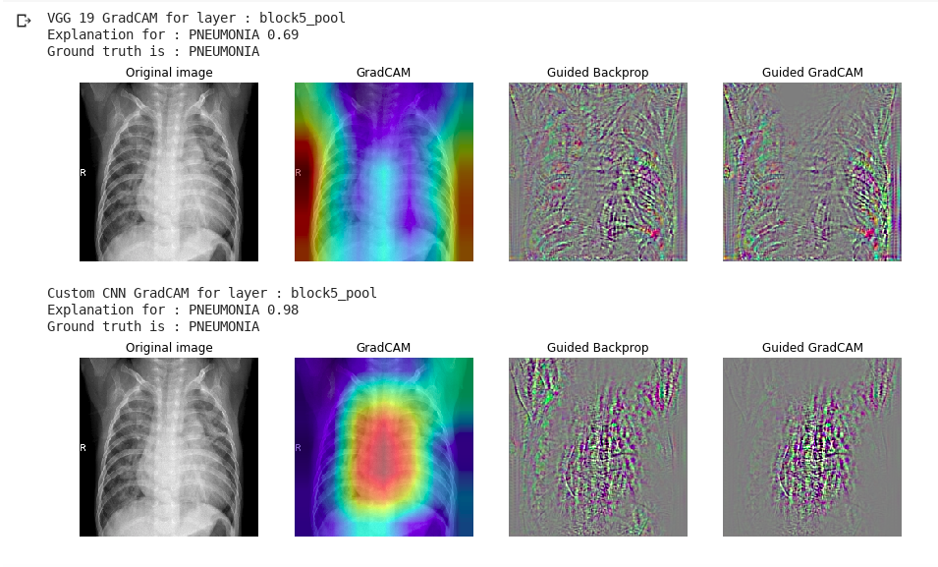
Prediction visualisation for last conv layer

Slide 28
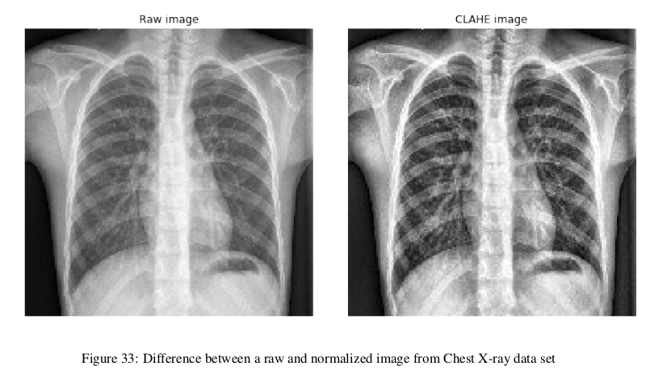
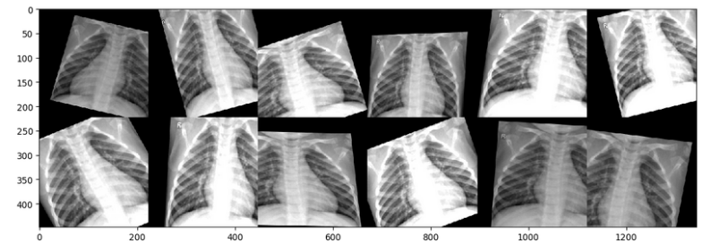
Other tricks we used
Pixel regularization no improvement may be combined with raw image | Data augmentation good improvement for smaller datasets (5~10%)

Slide 29
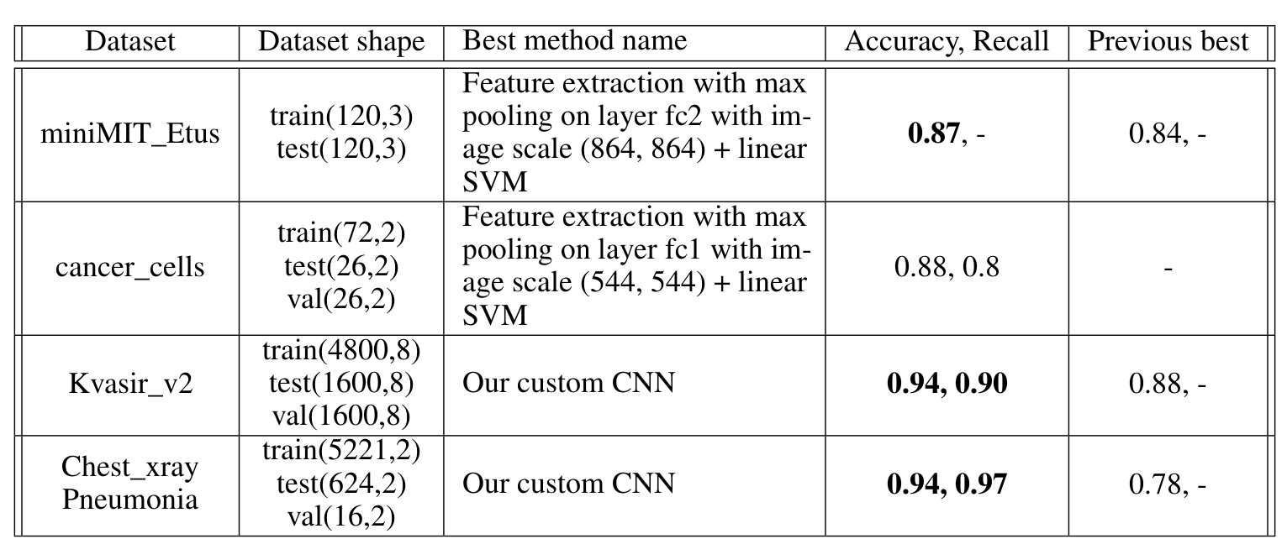
Final results

Slide 30
Conclusion
4 data sets of various properties
Transfer Learning scenarios to use for a image classification project
Size of the data set and its similarity to the original data set matters
Large ⇒ fine-tuning of a pre-trained network
Small ⇒ linear classifier on fully connected layers from a pre-trained network.
VLAD ⇒ not so relevant but could improve the accuracy from the last convolutional layer
In case the data set you use is very similar to the ImageNet data set, you should just use the best pre-trained network available nowadays
Excellent neural network in regards of metrics NOT always useful
Output should be relevant for humans.

